Slide 1





CHAT
APPLICATION

Slide 2
PROJECT CHAT APPLICATION
MOHAN DOSS.L
TAMIL SELVAN .J
RANJITH KUMAR.V

Slide 3

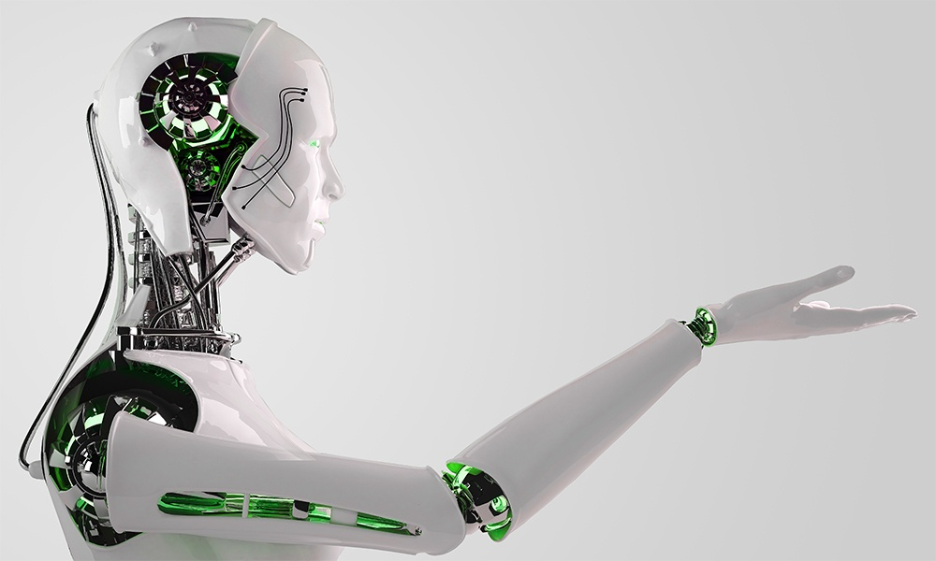

DEFINITION
USER ACCOUNT
An account is used to store the information about the user such as phone number and user name on a network server.its allows the user to change their status,exchange the photos and videos over the network using their mobile data and operating system

Slide 4

Project scope
Whats app is a online instant message application test that integrates user contacts from their phonebook with the application and enable exchange of message and document free of cost cover internet
Chat application

Slide 5
Product features
The whats app aplication should work 24 hours.the application identiefies a customer by his/her phone number.its collects information about the contact of the user communicates the people
SRS DOCUMENT:https://github.com/Raffihq/RANJITH/tree/9a2511ed0b716391027768919bf9d0720f9c20cf
Chat application
Whats app
Facebook
Messanger
Snapchat
telegram

Slide 6
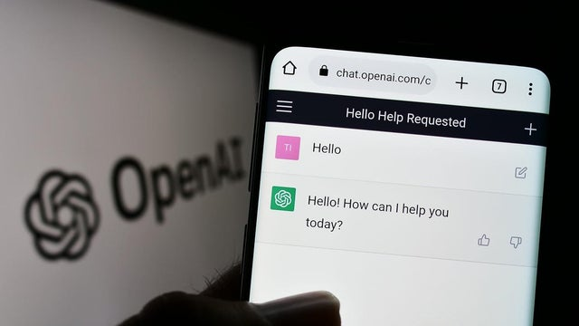
Chat application Goals
Show many goals are be ready
Chat gpt also use us chat application in real world
The goals of chat application are to develop and promote friendly AI in a way that benefits all of humanity. They conduct research in a variety of areas related to AI, including machine learning, computer vision, natural language processing, and robotics.

Slide 7

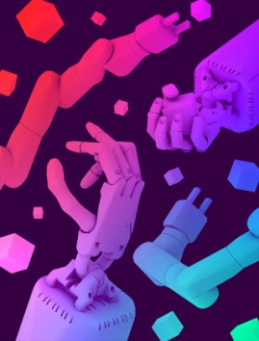

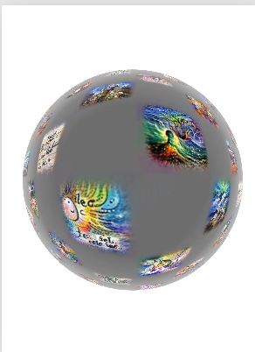
Generative Models
Ingredients for Robotics
CHAT APP
Chat app is mostly use on people .its develpoped communication one people to so many people to develop the realtionship on people
Solving Rubik’s Cube with
Multimodal Neurons in Artificial Neural Networks

Slide 8
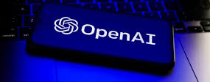
Built With chat application
Our chat application has been deployed in thousands of applications with tasks ranging from helping people learn new languages to solving complex classification problems.
GitHub Copilot
AI pair programmer that helps you write code faster with less work. Using Codex, GitHub Copilot applies the context in your editor and synthesizes whole lines and even entire functions of code.
Keeper Tax
Helps freelancers automatically find tax-deductible expenses by using to interpret data from their bank statements into usable transaction information.
Viable
Helps businesses better and more quickly understand what customers are telling them by using language models, including to analyze customer feedback and generate summaries and insights.

Slide 9
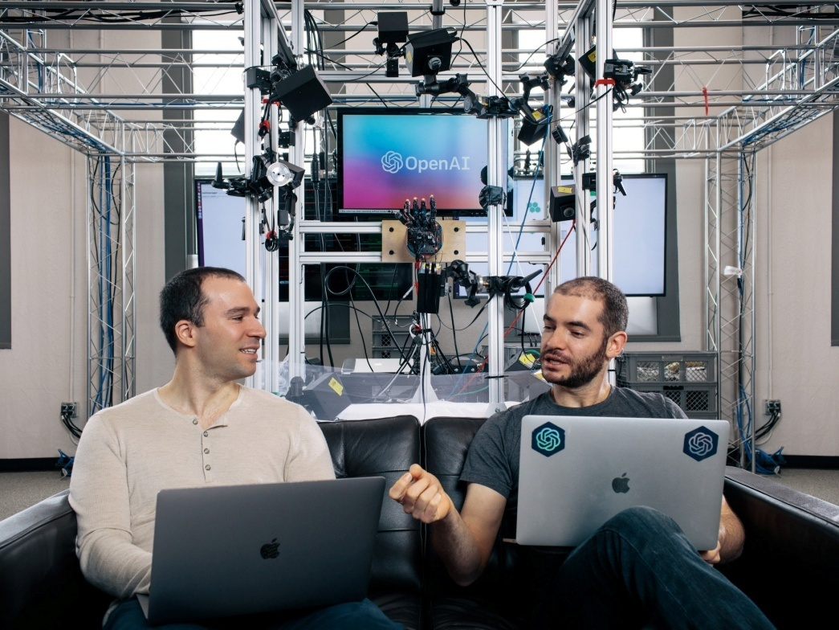

Chat application
Mission
Chat application mission is to ensure that artificial general intelligence (AGI) benefits all of humanity. The company has a strong emphasis on transparency and open research, and they release many of their research papers and models under open-source licenses.
Chat application also offers a cloud-based platform for developers and researchers to access and use their AI models and tools.

Slide 10

Chat app
Vision
Chat app vision is to develop and promote friendly AI in a way that benefits all of humanity. The company aims to create AI that can help humanity achieve its potential by making it more intelligent and capable and by ensuring that it is aligned with human values and developed in a safe and responsible manner.

Slide 11
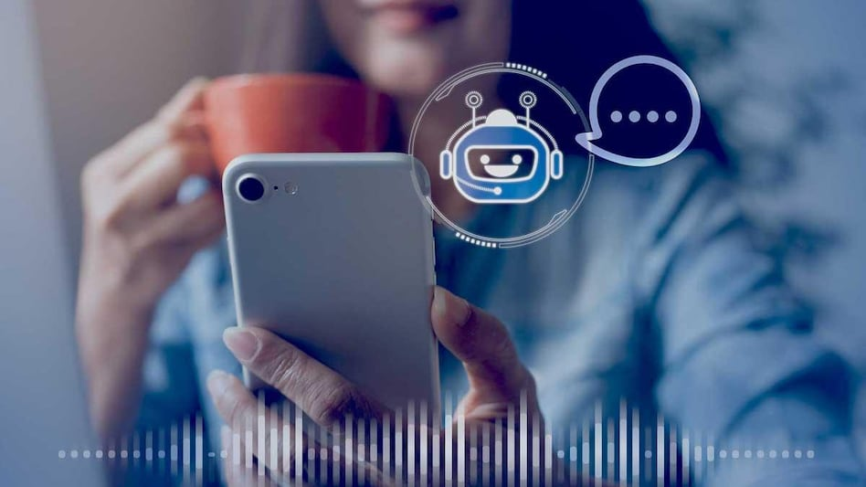
Language Generation
Question Answering
Text Completion
Language Translation
Summarization
Chat application Usage

Slide 12
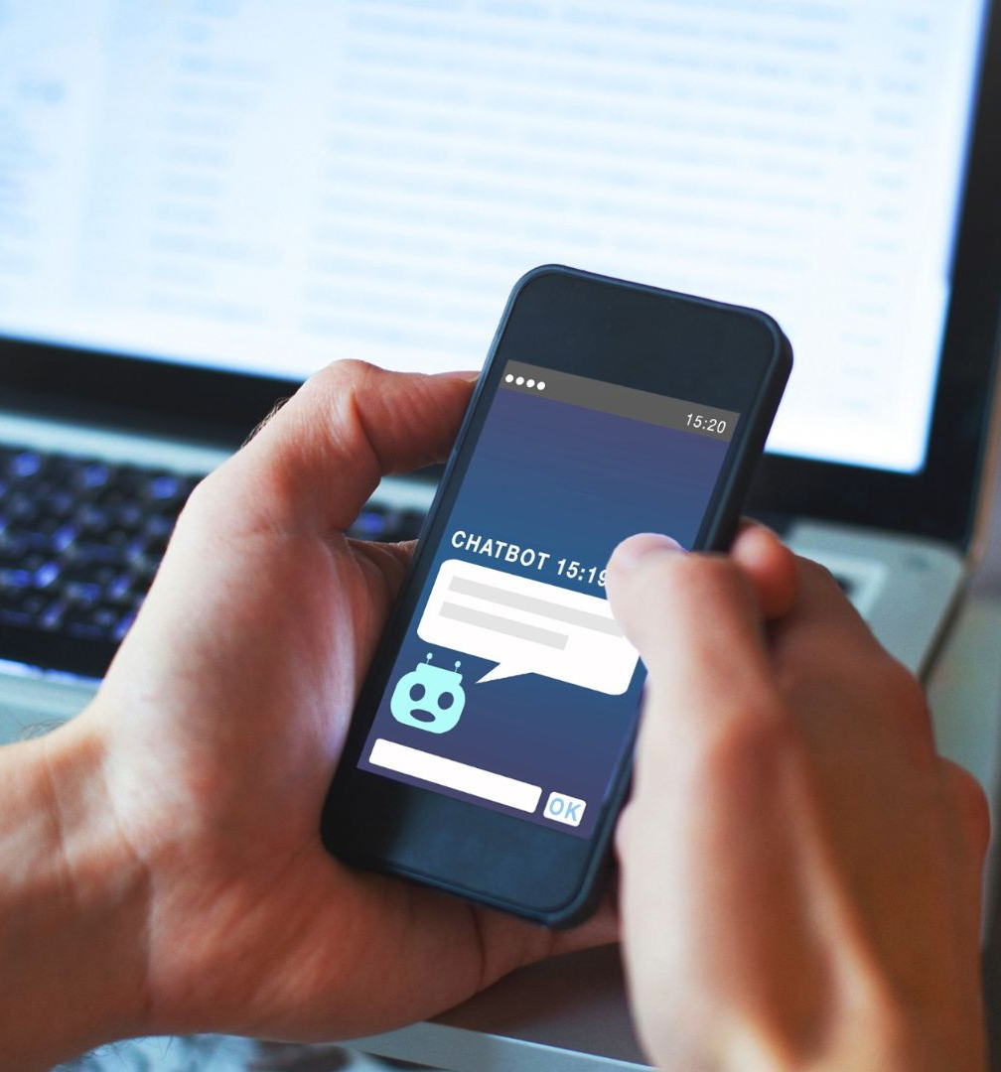
Chat application Advantage
:
1. High Quality of Generated Text
2. Cost
effective
3. Large
Vocabulary
4. Speed
5. Easy to use
6. Flexibility

Slide 13

OpenAI’s
Strategy
1. Research
Chat app conducts research in a variety of areas related to AI. Research aims to advance the state of the art in AI and make it more beneficial to humanity.
3. Partnerships
Chat app partners with other organizations, such as companies and universities, to access resources and cutting-edge technology.
OpenAI's strategy is to develop and promote friendly AI in a way that benefits all of humanity. To achieve this goal, OpenAI employs a multi-faceted approach that includes
2. Development
Chat app develops advanced AI technologies that can perform a wide range of tasks, such as language translation and image generation.
4. Education
Chatt app provides educational resources, such as tutorials, papers, and blog posts, to help people learn more about AI and how it can be used.

Slide 14
Terms Of Use (Free Users)
If you are a free subscriber, you should credit SlideEgg by keeping the “Thank You” slide.
Kindly refer to the following slide for the Terms of Use for premium users.
You can:
Customize or edit this template
Use this template for both business and personal endeavors.
You can not:
Sell, rent, or second-license SlideEgg content or its altered version. Promulgate, unless explicitly permitted, SlideEgg content, by SlideEgg.
Incorporate SlideEgg content in any database or file online or offline.
Obtain SlideEgg content’s copyright.
Kindly refer to our Tutorial page or FAQ for advanced slide modification guidelines.

Slide 15





Thank You

